Slide 1

Phase III project: classification of borrower creditworthiness
Magali Solimano
september 2022

Slide 2
Table of contents
Problem Statement
Goal
Data Understanding
Results
Recommendations
Next Steps

Slide 3
Problem statement
A German bank is struggling to identify creditworthy borrowers:
Missed business opportunities to extend credit to good borrowers
Increasing credit losses from non-performing loans

Slide 4
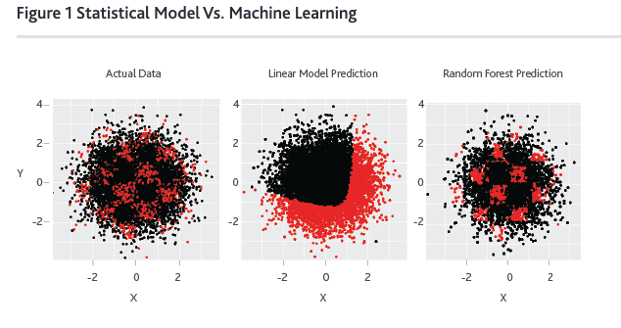
Goal
Build a machine learning model that is trained to assess and predict credit risk of borrowers (creditworthy / not creditworthy)
Actual Data Linear Model Prediction Machine Learning Prediction

Slide 5
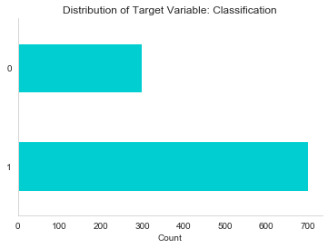
Data understanding
Data
German credit data
Methods
Descriptive data analysis and statistics
> 1,000 records
Machine learning
21 variables
Not creditworthy (30%)
Creditworthy (70%)

Slide 6
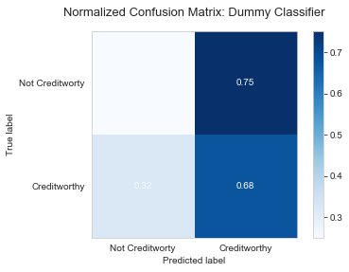
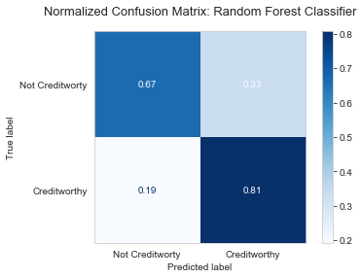
results
Model correctly predicts 81% of true creditworthy classifications
Reduces false positives and false negatives
Baseline Model Selected Random Forest Model
0.25
0.33
0.32

Slide 7
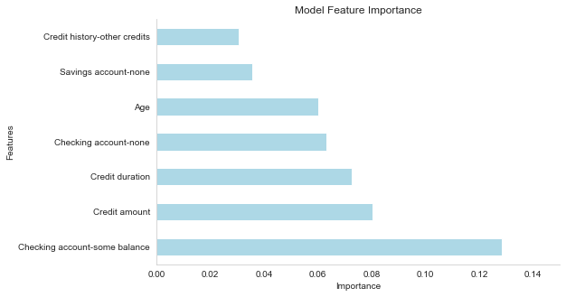
results
Accuracy score of 77%
Precision score of 85%

Slide 8
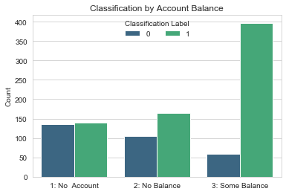
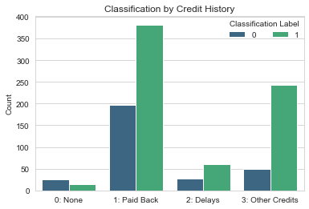
recommendations
Target making loans to borrowers:
With some balance in their checking accounts
Who have paid back previous loans duly
Who have other existing credits

Slide 9
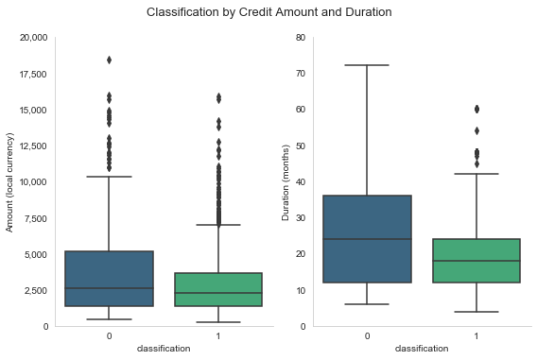
recommendations
Target making loans with terms:
Average balance of $3,000
Average duration of 19 months

Slide 10
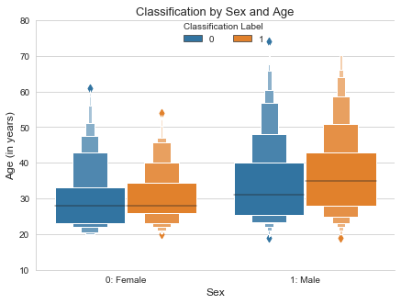
MODEL BIAS
Model favors classifying older men as creditworthy

Slide 11
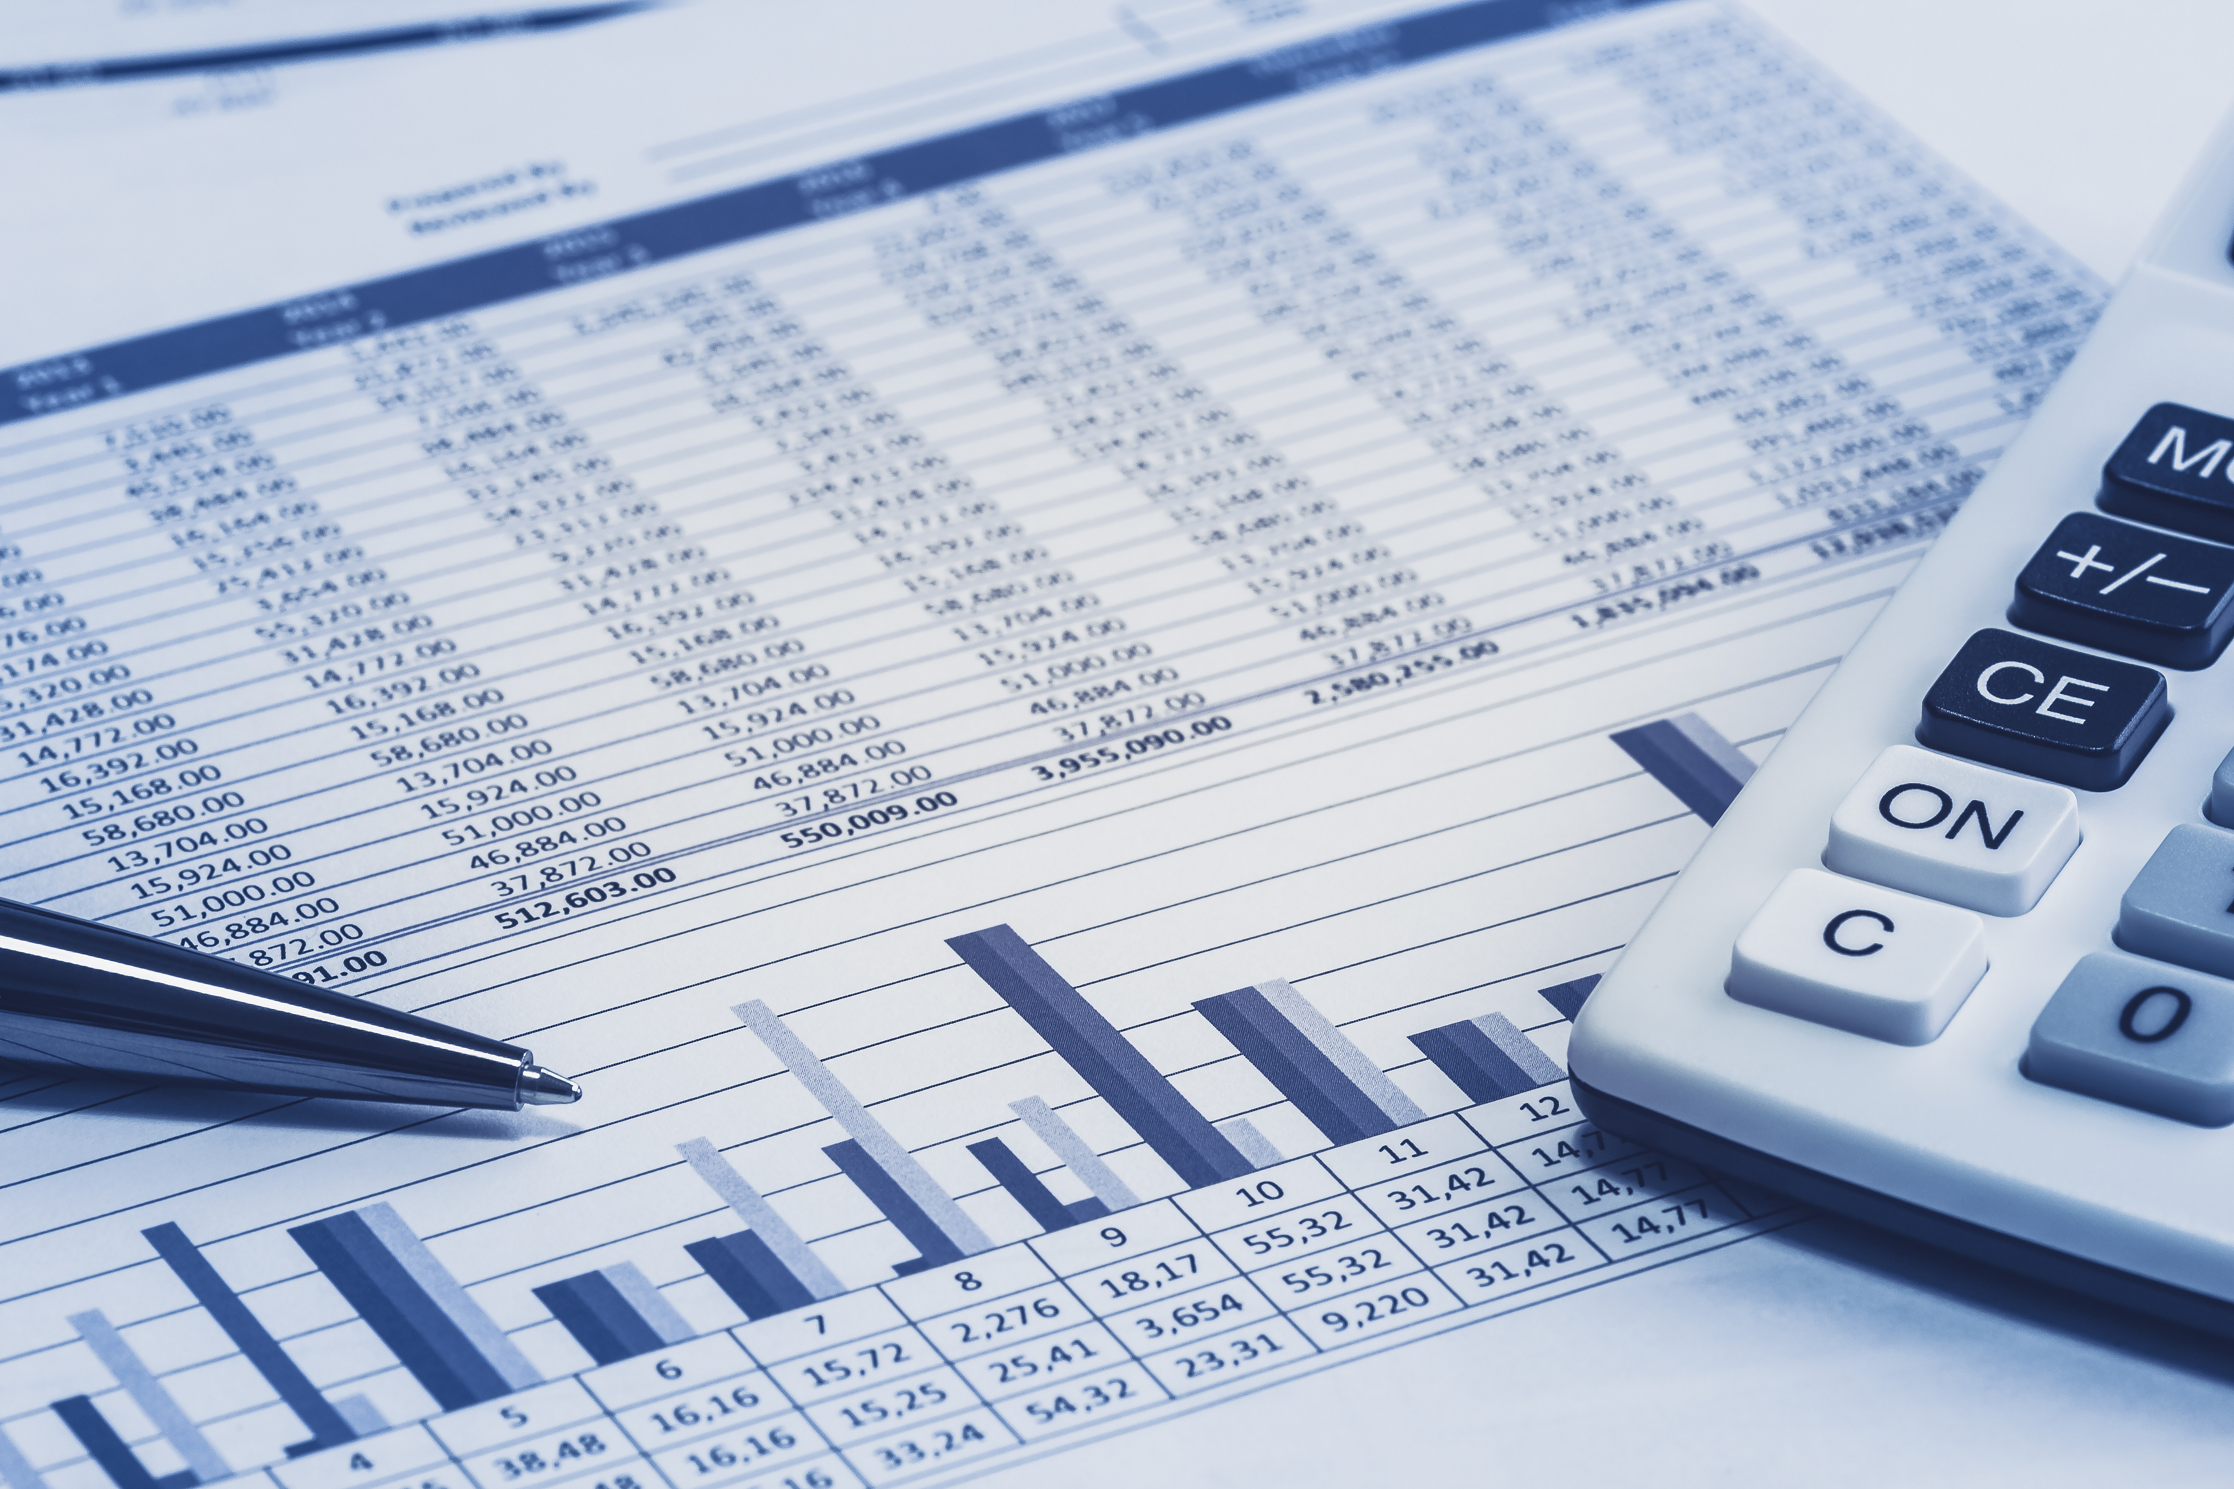

NEXT STEPS: extended analysis
Evaluate ML model’s performance against traditional credit risk assessment
Reduce model biases in order to promote fair and equitable decision-making

Slide 12
Thank you
For questions, contact:
Magali Solimano
magali.solimano@gmail.com

